Slide 1
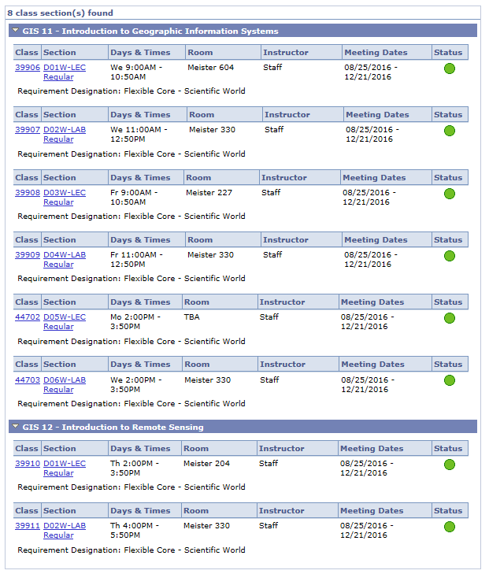
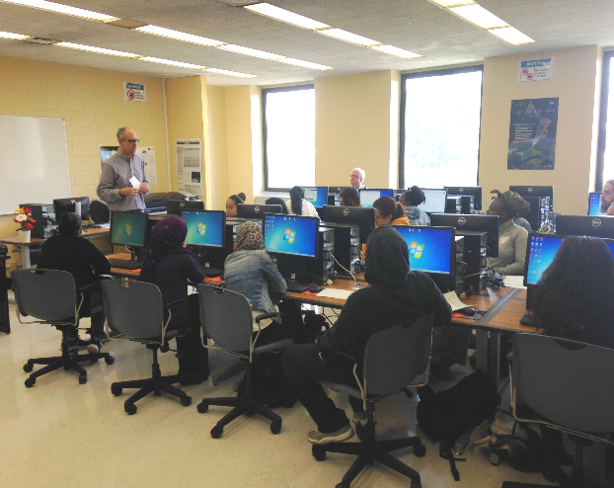
LEARN GEOSPATIAL TECHNOLOGY AT BCC
PATHWAYS COURSES ENABLE SMOOTH TRANSFER TO SENIOR COLLEGES
Fall 2016 Schedule
Contact
Dr. Sunil Bhaskaran
Director-Geospatial Center of the CUNY CREST Institute (BGCCCI)
Meister Hall Room# 807
Tel: 1-718-289-5566/5233
Email: Sunil_director.bgccci@bcc.cuny.edu
GEOSPATIAL COMPUTING CENTER
Meister Hall Room# 330

